Slide 1

Big data platform (Spark) performance acceleration
Mentors: Tony Tan, Ning Wu, Yong Wang and Theo Gkountouvas
By:
Grishma Atul Thakkar
Virat Goradia
Nipun Midha
Baoshu Brady Qi

Slide 2

Sprint Goals
Understand existing spark code
Find the appropriate data set
Start implementing the N-Way merge algorithm
Research on ways to implement the N-Way merge

Slide 3
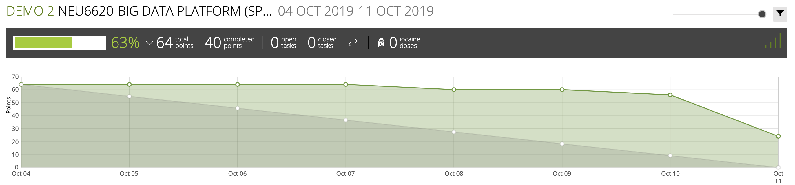
Burndown Chart

Slide 4

Spike

Slide 5
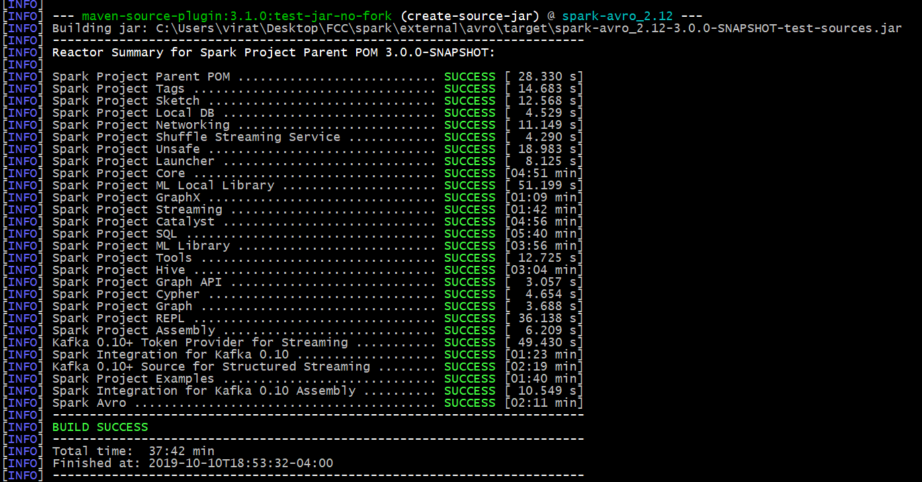
Building Spark Code

Slide 6

Spark Codebase
839,842 lines of code

Slide 7
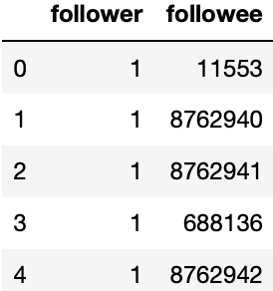
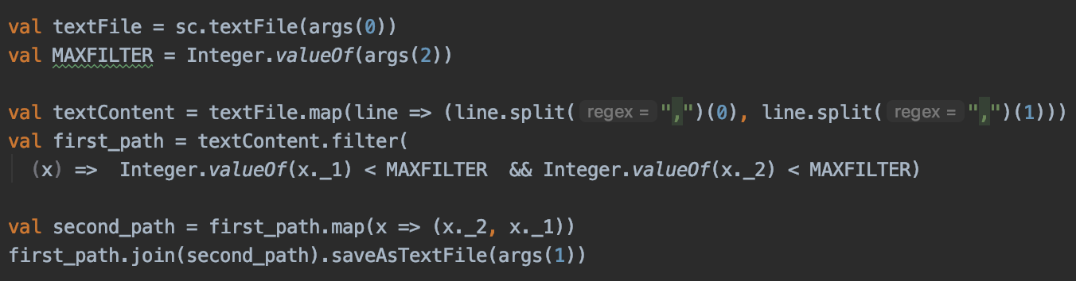
Demo
m4.large
4 Cores, 8GiB memory, 32GiB EBS storage
MAXFILTER = 15,000
Notes:
Still use the twitter graph dataset in demo 1, but we set a max-filter this time to reduce the input and output size linearly.
We run a simple self-join program on a cluster of 1 master and 4 workers. Each machine is 'm4.large', 4 cores, 8g memory
This entire program finishes within 3 mins and create an output size of 24g. But we didn't observe the file spillage as we expected.
Then we discussed and managed to do another join based on that.

Slide 8
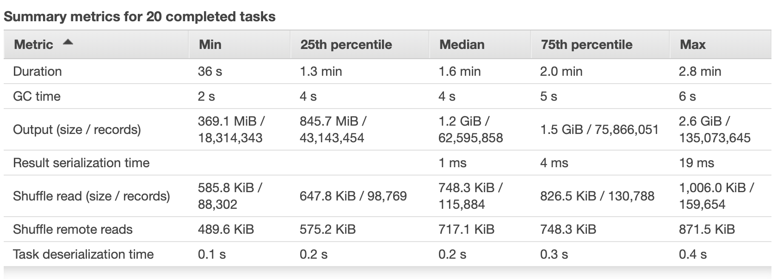
Demo
Notes:
Still use the twitter graph dataset in demo 1, but we set a max-filter this time to reduce the input and output size linearly.
We run a simple self-join program on a cluster of 1 master and 4 workers. Each machine is 'm4.large', 4 cores, 8g memory
This entire program finishes within 3 mins and create an output size of 24g. But we didn't observe the file spillage as we expected.
Then we discussed and managed to do another join based on that.

Slide 9
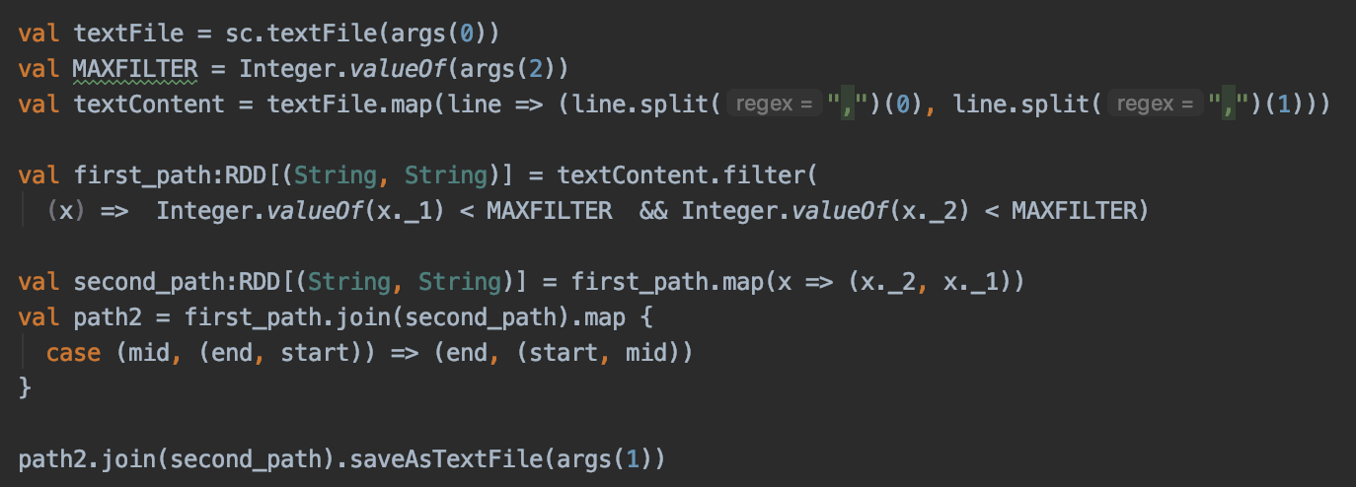
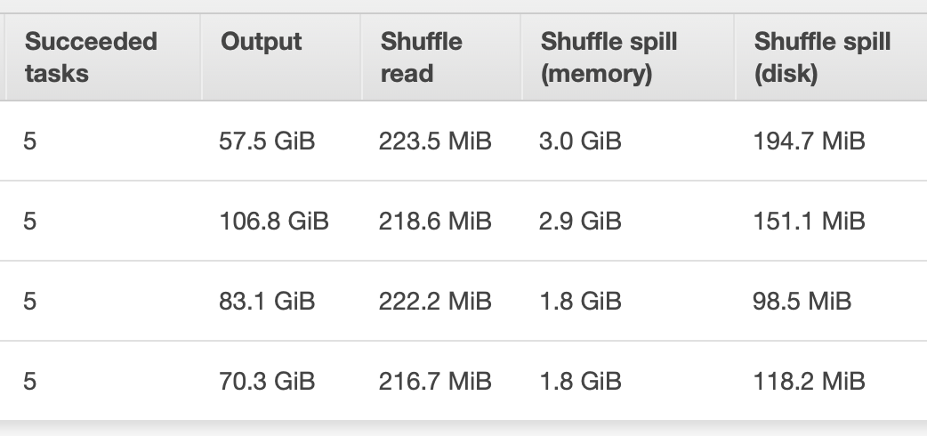
Demo
Notes:
Still use the twitter graph dataset in demo 1, but we set a max-filter this time to reduce the input and output size linearly.
We run a simple self-join program on a cluster of 1 master and 4 workers. Each machine is 'm4.large', 4 cores, 8g memory
This entire program finishes within 3 mins and create an output size of 24g. But we didn't observe the file spillage as we expected.
Then we discussed and managed to do another join based on that.

Slide 10
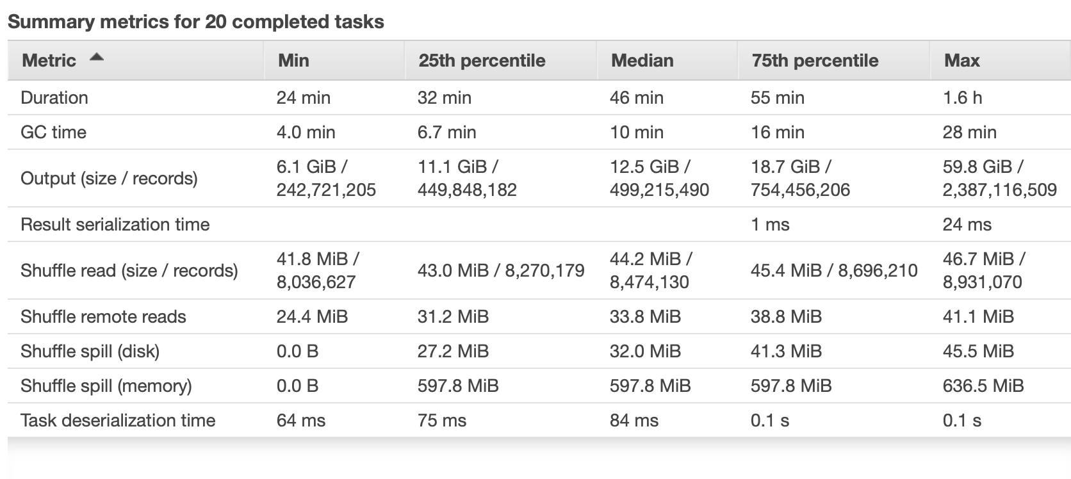
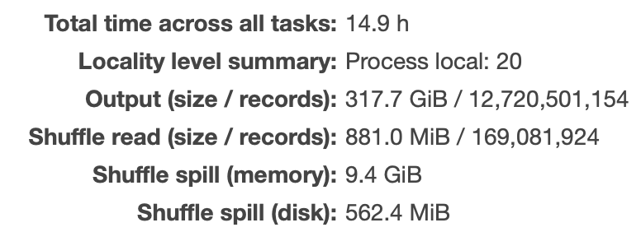
Demo
Notes:
Still use the twitter graph dataset in demo 1, but we set a max-filter this time to reduce the input and output size linearly.
We run a simple self-join program on a cluster of 1 master and 4 workers. Each machine is 'm4.large', 4 cores, 8g memory
This entire program finishes within 3 mins and create an output size of 24g. But we didn't observe the file spillage as we expected.
Then we discussed and managed to do another join based on that.

Slide 11
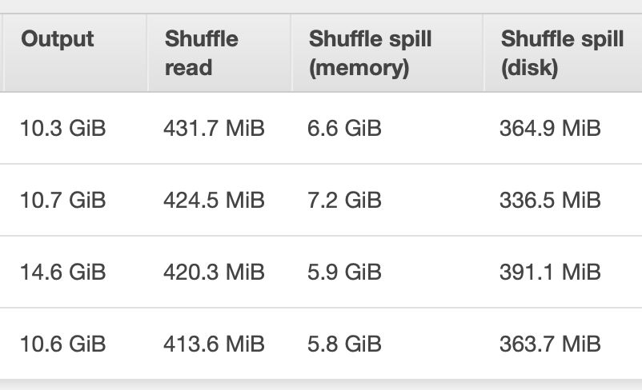
MAXFILTER = 30,000
Terminated manually, after the cluster running about 3h30min.
Possible solutions in the future on how to get spillages:
Multiple join actions on relatively small dataset
Use machines with smaller memory
Alternatively, manually set smaller executor memory, shuffle memory, etc.
--spark.executor.memory
Notes:
Here we also did some tests on larger max-filter. we had to manually shut the cluster down because it's still running after 3h30min. Obviously, more spillage appears.
After discussions and digging, we have some solutions/conclusions on the program. 1. run multiple self- joins would work even if with small input file. Or we can choose machines with smaller memory size, m4.large has 8g memory, other machine have 4 or 2. and alternatively, we could let spark running on smaller memory, there is a parameter called spark executor memory, we could set it to 2 to 4g in order to get spillage more efficiently.

Slide 12
Important Files
ShuffleManager
SortShuffleWriter
BlockStoreShuffleReader
ShuffleMapStage
ShuffleWriteMetrics

Slide 13
ShuffleManager
Register Shuffle
Unregister Shuffle
Get ShuffleReader
Get ShuffleWriter
Stop the shuffle system
Notes:
1) ShuffleManager is the contract of shuffle systems that manage shuffle metadata on the driver (using shuffle IDs or ShuffleHandle)
and allow active tasks on the executors to access the metadata.
Default is SortShuffleManager
2) getReader gives a "ShuffleReader" object, which is used by the RDD'S when they compute partitions.
3) getWriter gives a "ShuffleWriter" object, to write the map output generated.

Slide 14
ShuffleMapStage
ShuffleMapStage is an intermediate stage that produces data for other stage(s). It writes map output files for a shuffle.
When all map outputs are available, the ShuffleMapStage is considered available (or ready).
ShuffleMapStage uses outputLocs and _numAvailableOutputs intern-al registries to track how many shuffle map outputs are available.
outputLocs gives us information of the MapStatus (Ready or not).
NumAvailableOutputs gives us the information as to how many "ready" outputs are available, which would help us in the N-way merge algorithm.

Slide 15
ShuffleWriteMetrics
ShuffleWriteMetrics tracks the following metrics:
A) Shuffle bytes written
B) Shuffle Write time
C) Shuffle records written
Expected observation:
Shuffle bytes written must remain the same.
Shuffle write time must decrease.
Shuffle records written must decrease.

Slide 16
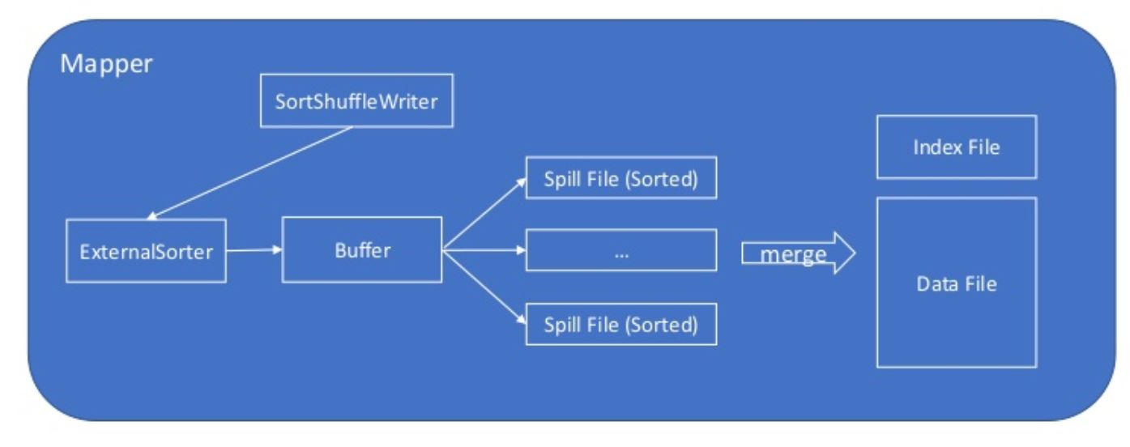
SortShuffleWriter
Notes:
Sort he trecords partion id, to seprate records of differnt partions
ExternalSorter
Sorts and potentially merges a number of key-value pairs of type (K, V) to produce key-combiner
pairs of type (K, C).
We repeatedly fill up buffers of in-memory data
Inside these buffers, we sort elements by partition ID and then possibly also by key.
To avoid calling the partitioner multiple times with each key, we store the partition ID
alongside each record.
When each buffer reaches our memory limit, we spill it to a file. This file is sorted first
User ask for file output, the spilled files are merged, along with
any remaining in-memory data,

Slide 17
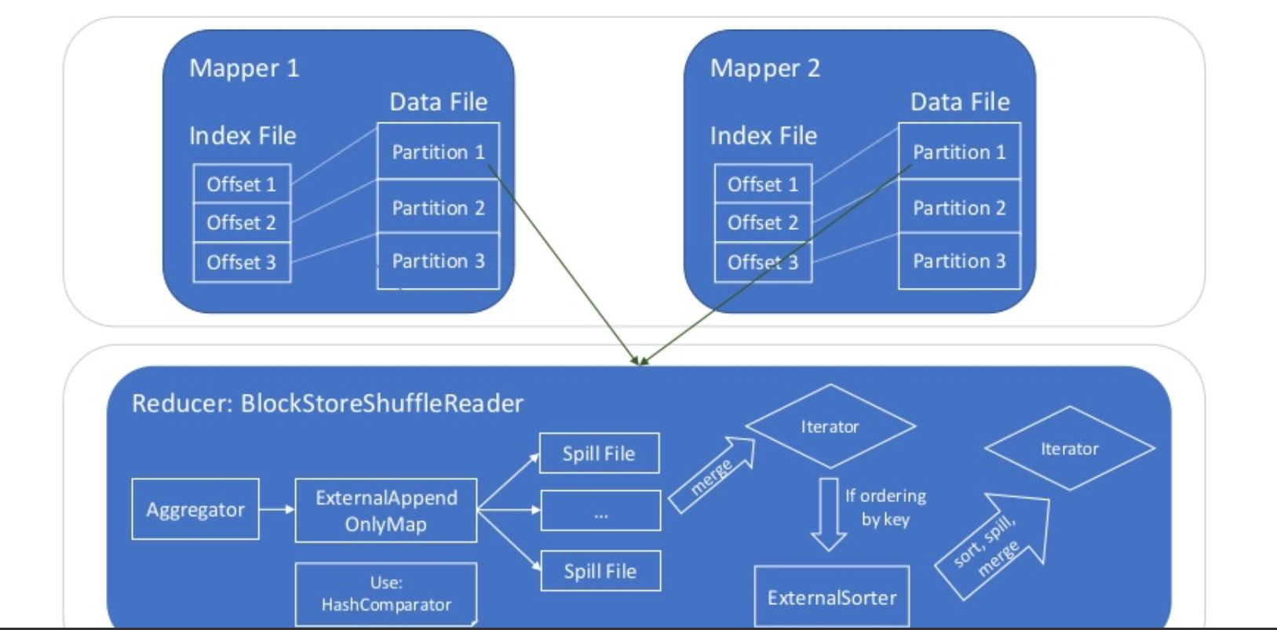
BlockStoreShuffleReader
Notes:
Fetches and reads the partitions in range [startPartition, endPartition) from a shuffle by requesting them from other nodes' block stores.
Create a key/value iterator for each stream

Slide 18




Challenges

Slide 19
Next Sprint Goals
Understand existing spark code
Find the appropriate benchmarks
Research on ways to implement the N-Way merge
Start implementing the N-Way merge algorithm

Slide 20

Thank You!
Any Questions?

